Slide 1
3

Slide 2
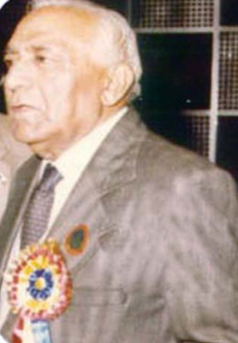
Prof R. P Dhanda award
The first successful corneal transplant was performed by Prof. RP Dhanda in Indore.
Most of the keratoplasty work in India, in the years until 1970s, was performed by Dr RP Dhanda and Dr Kalevar.
Award-Every 3rd year: Given to a Regular Life Member/Honorary RLM with a minimum of 20 years standing and outstanding community service in Ophthalmology.
Also, every 3rd year. Best free paper on “Cornea” by a RLM.
Prof R. P Dhanda

Slide 6
3

Slide 10
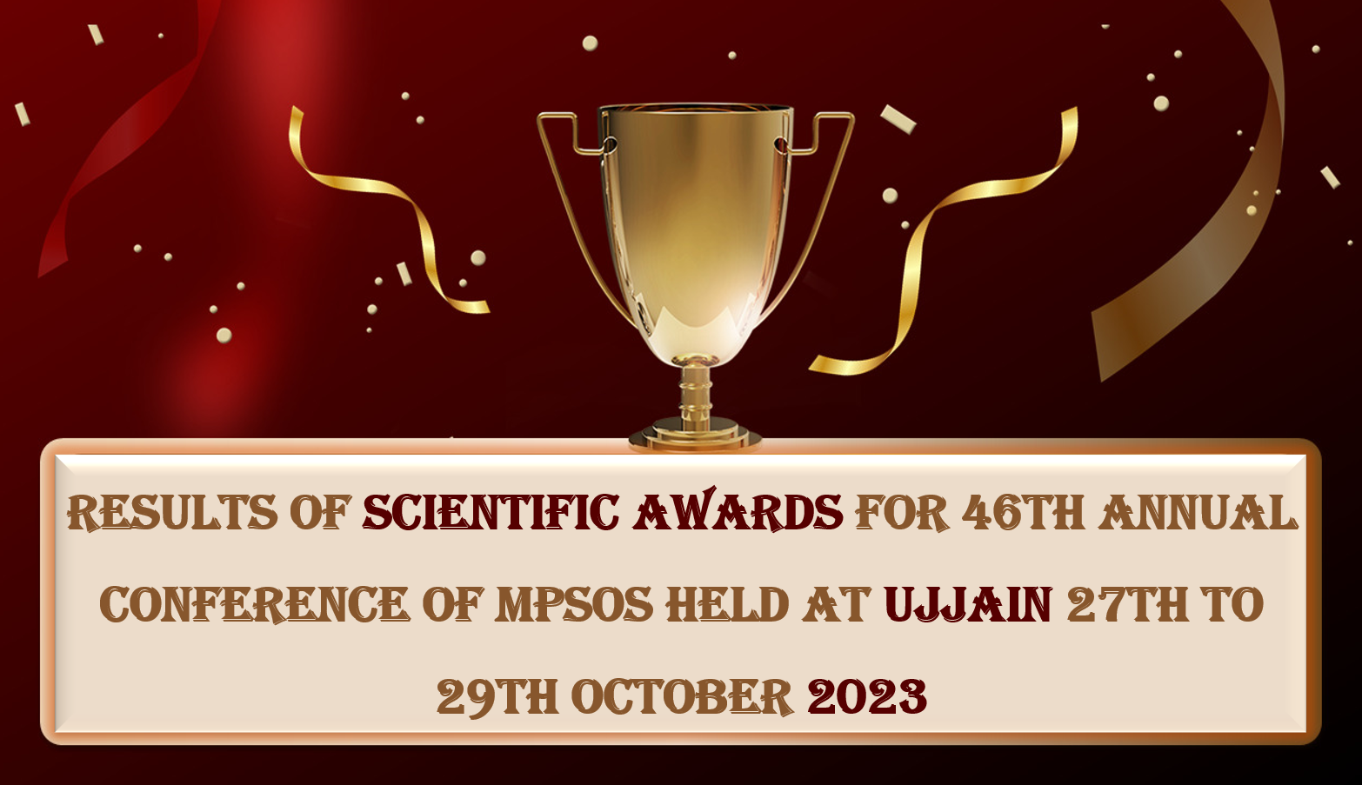

Slide 11
Dr DNS Choudhary award
He took Rewa Medical college to a great height as a Dean (1969-71).
He was a great teacher, a great administrator and a noble heart.
Award for the overall “Best Free Paper of the Year” by a RLM is awarded in his memory.

Slide 13
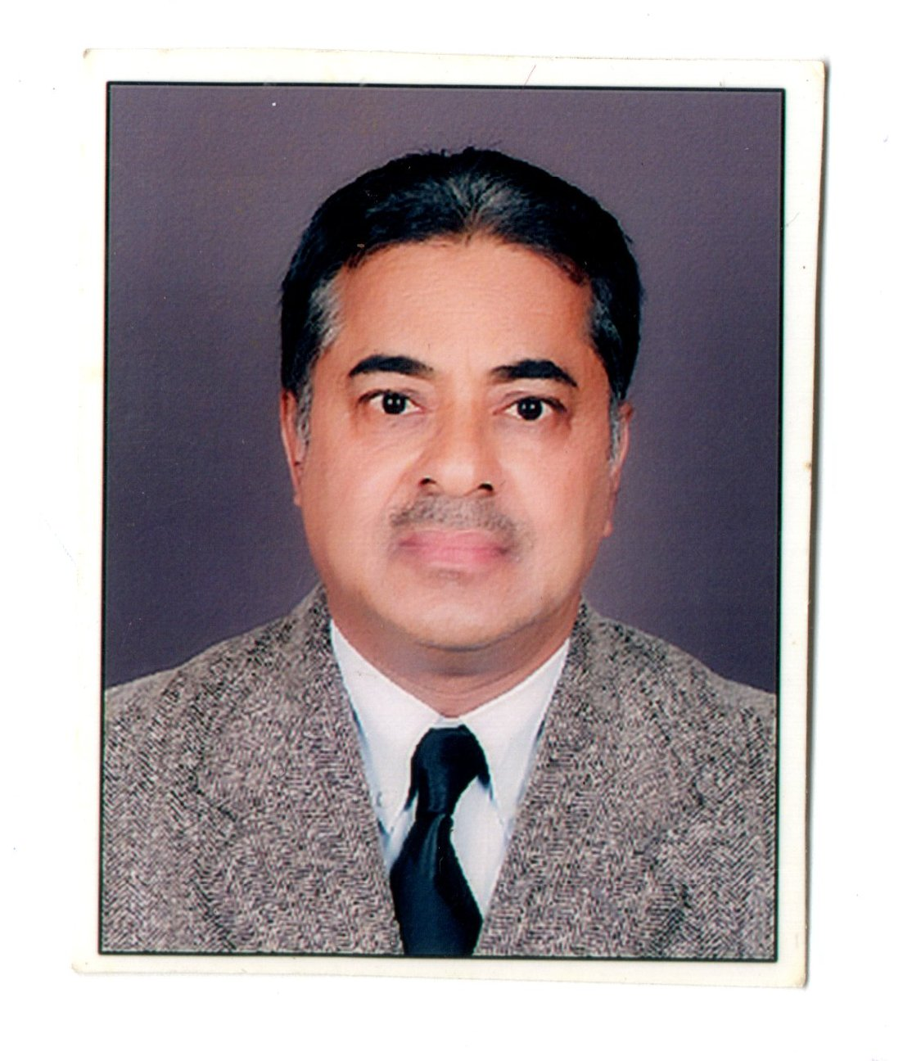
Dr H C Setiya award
Completed his MS in ophthalmology from GRMC, Gwalior he went on to establish Jeevan Jyoti Netralaya.
Passionate advocate for vision restoration, and community eye health.
Was given a special honor in Community service by the late Madhav Rao Scindia ji
Pioneer member who helped set up Birla Institute of Medical Sciences in Gwalior 1981 now a 300 bedded multispecialty hospital
President of MPSOS for 2004 -2005 when the award was first given
Video Award for the best video on “Management of the surgical complication” presented by RLM
Dr H C Setiya

Slide 14
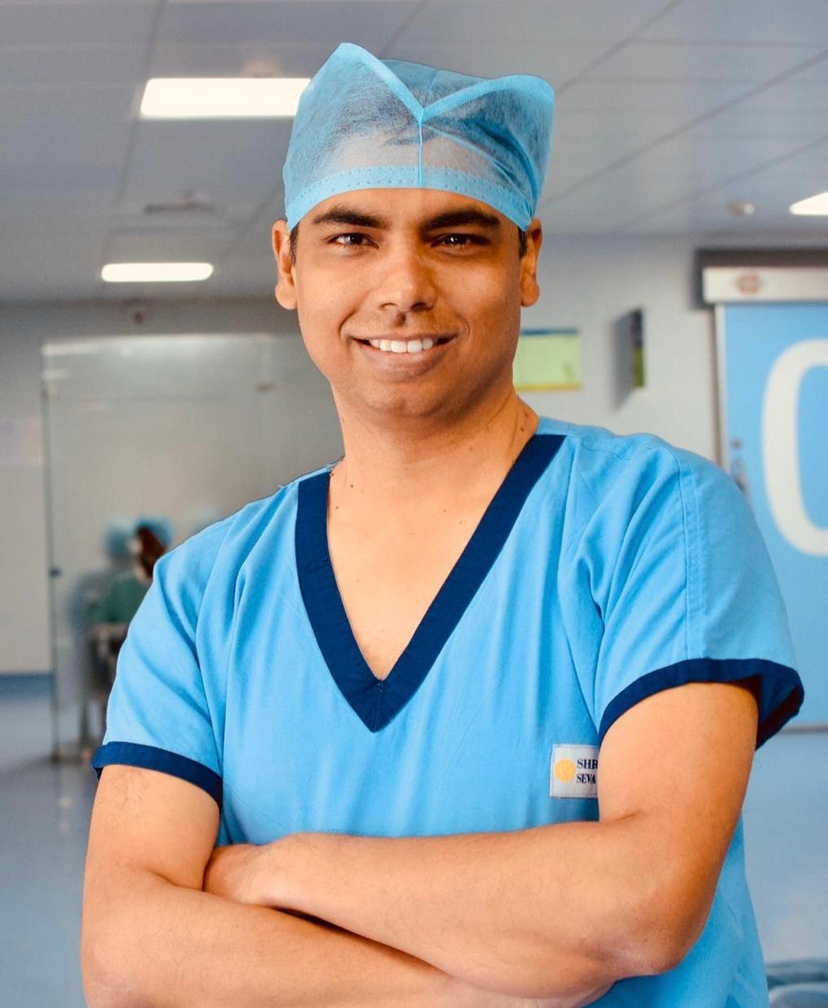

Slide 15
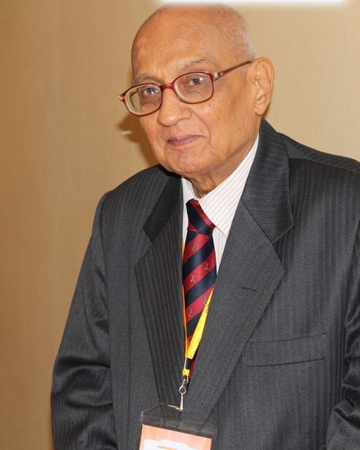
Prof. B. Shukla award
Every 3rd year. Best “Grass Root Free Paper” by a RLM working/practicing at a district level or below.
MAMS, then FAMS from National Academy of Medical Sciences
1st Indian to get PhD from University of London
1st Indian Ophthalmologist to be awarded D.Sc. (Jiwaji Univ.)
His thesis was quoted in Duke Elder book
Award: Every 3rd year. Best “Grass Root Free Paper” by a RLM working/practicing at a district level or below.
Prof. B. Shukla

Slide 17
Prof R. P Dhanda award
The first successful corneal transplant was performed by Prof. RP Dhanda in Indore.
Most of the keratoplasty work in India, in the years until 1970s, was performed by Dr RP Dhanda and Dr Kalevar.
Award-Every 3rd year. Best free paper on “Cornea” by a RLM.
Prof R. P Dhanda

Slide 20
Dr J K Raizada award
Dr Jay Krishna Raizada was a leading Eye Doctor, Dedicated to Lionism
Efficient administrator while working as head of the department, later Dean, GMC, and Joint Director of Medical Education at the Government of Madhya Pradesh.
Dr Raizada was awarded the national level “Indira Gandhi Priyadarshini Samman" for his achievements in the field of ophthalmology. For this exemplary work, he was nominated for the “Padma Award” in 2015.
He wrote three remarkable books: “Muktibodh”, “Yantraraj Shriyantra” and “Durgasaptakoshi
Award: Every 3rd year. Best free paper on “Cataract”

Slide 22
Haripad Datta Award:
Every 3rd year. Best paper in community ophthalmology by a RLM.
A collective award” shall be given to an affiliated “District Ophthalmological Society” for outstanding ophthalmic public service and academic activity of the ophthalmologist in the district. The report after factual verification shall be submitted by the Secretary of the District Ophthalmic Society to the General Secretary.
Divisional districts like Bhopal, Gwalior, Indore, Jabalpur, Rewa, Sagar, Ujjain etc shall not be eligible for this award.

Slide 24
Teachers Medical (Under 40 yrs. of age) Award: Every year. For a single author paper presented by a regular life member who is a regular teaching faculty in a medical college of M.P., and under 40 years of age.

Slide 26
Non-Teachers Award (Under 40 yrs. of age): Every year. For a single author paper presented by a regular life member who is under 40 years of age and not a teacher in a medical college.

Slide 35
Dr Kumud V A Joshi award
MS, DOMS
Served MP State Govt as an eye specialist
(1975-2007)
Extended services in rural area eye camps
Contributed in training for government of India
Sponsored program of National Control of Blindness in M.P (1992 December)
Award: Every year. Best free paper by a post graduate student member in a special session.
Dr Kumud V A Joshi

Slide 37
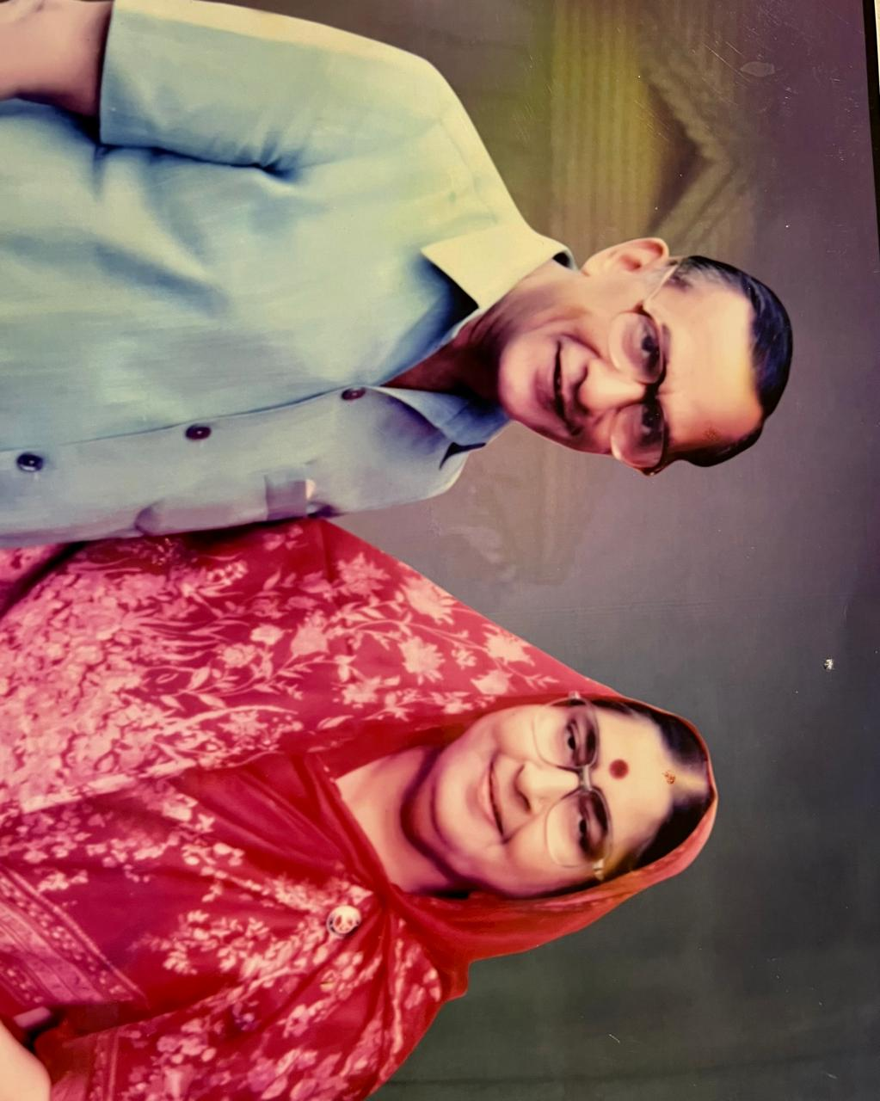
Dr Ramesh Krishna Agarwal Award
Started in 1955 under guidance of eminent teachers like Dr. Wale and Dr Dheer.
Treating patients with care compassion & kind words was his unique quality.
He was past District Governor for Rotary International
Mrs. Krishna Agarwal was a well-known social worker ,who worked in rural areas
She received the prestigious National Nehru literacy award for her contribution in educating rural women.
Dr Ramesh and his wife Krishna complimented and supported one another. The award is in their joint name as Ramesh Krishna award. Award: Every 3rd year. Best poster by a RLM.
Dr Ramesh and Mrs Krishna Agarwal

Slide 39
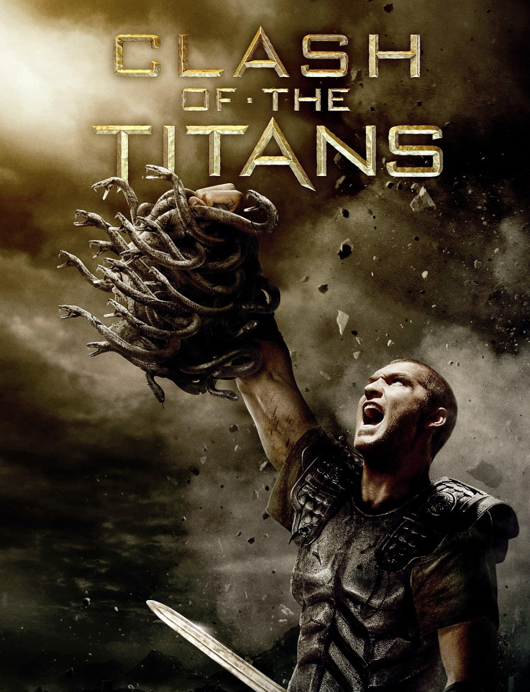
TEAM REWA- 2023
Dr Sashi Jain
Dr Rakesh Shakya
Dr Gautam Parmar
Dr Dhirendra Pandey
Dr Ashi Jain

Slide 40
PG WINNERS
(SEWA SADAN)
Dr Krishna Nimbalkar
Dr Neha Mota
Dr Anshul Shukla

